Slide 2
Button
Div na magiging modal
javascript

Slide 4
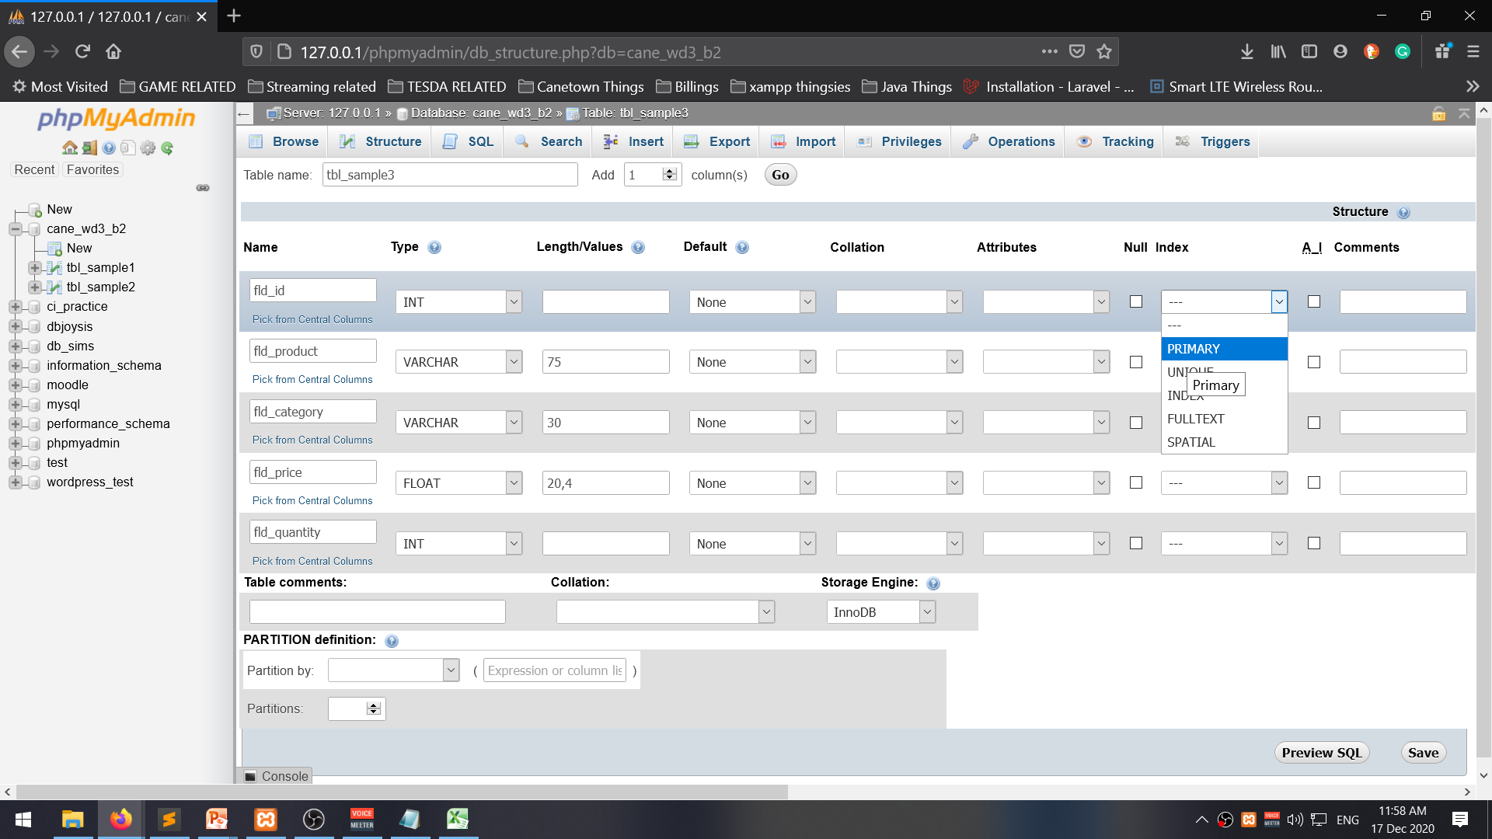

Slide 5
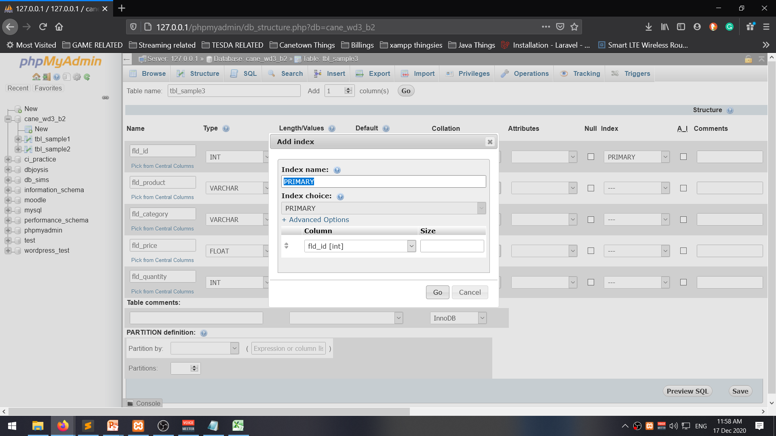

Slide 6
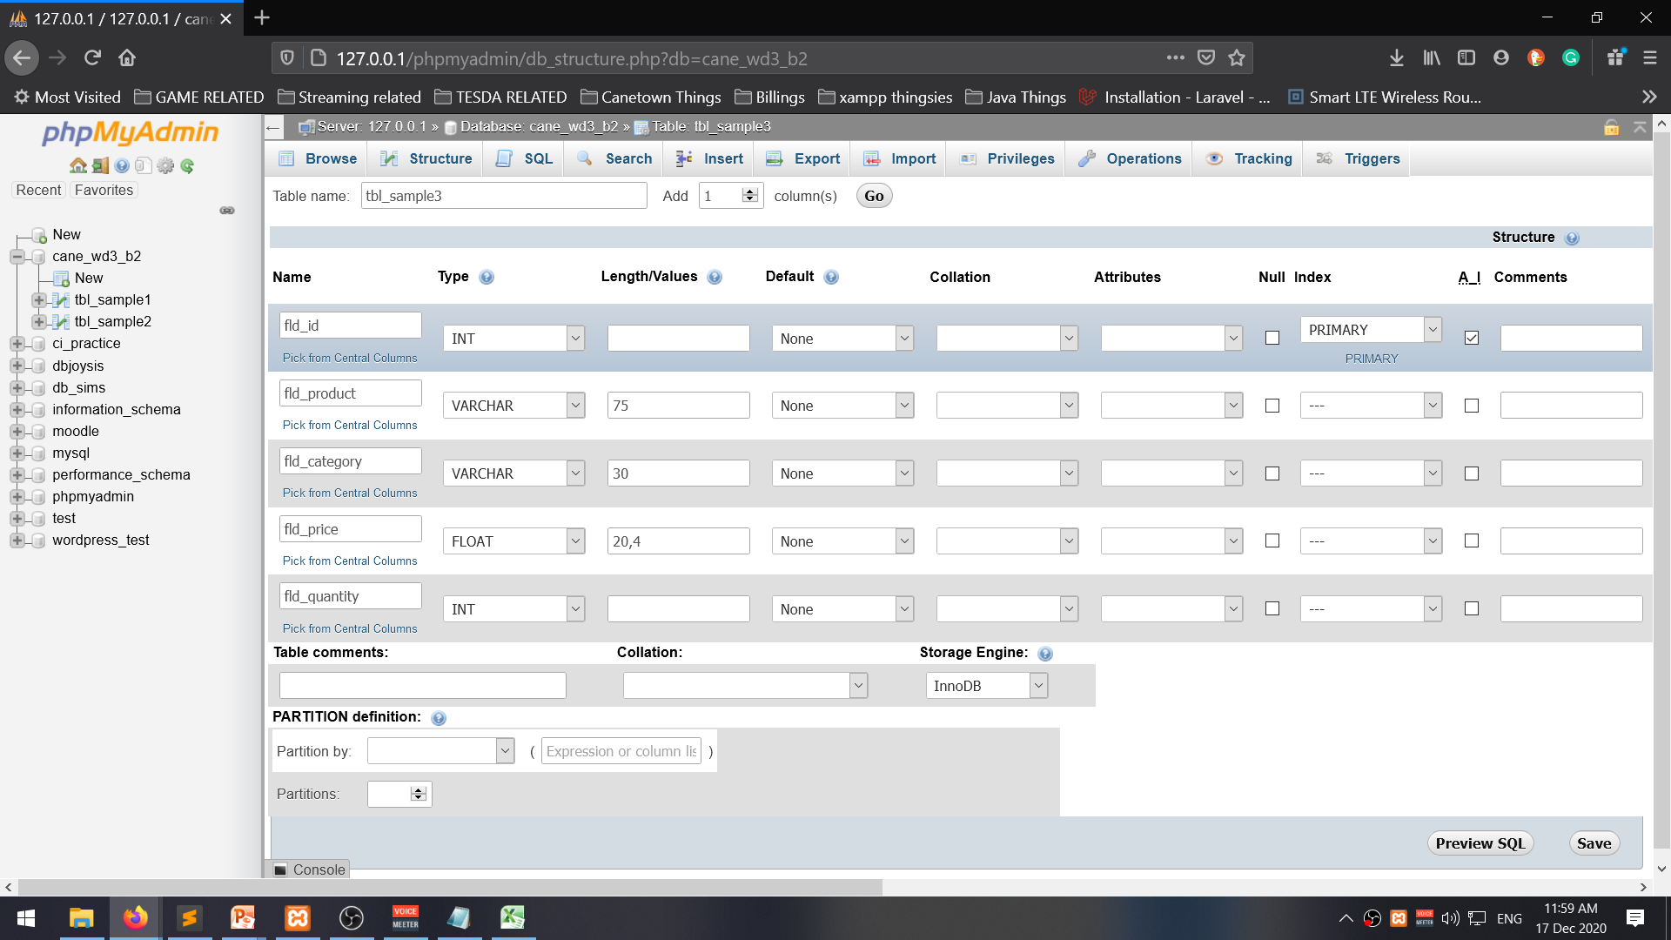
ai = Auto-Increment

Slide 7
User check
n
y
Pass check
n
y
WHERE fld_user = ‘__’ a AND fld_pass = ‘___’

Slide 8
Buying a list of products
Product list
Get list
Get next product on list
Is product available
n
y
Buy product,
record bought
Is that last on list
n
y
Show record bought

Slide 9
Monito monita requirements
Fld_color = red
Fld_taste = sweet
Fld_Price >=50
gift
Choose gift
Is gift >= 50
n
y
Is gift red?
Is gift sweet?
n
n
y
y
Give gift
fld_color=‘red OR fld_taste=‘sweet’ AND fld_price >= 50

Slide 10
Customer list
Product list
Order list
Product inventory

Slide 11
Odd or even
$num, $res, $group
$num = __
$res = $num % 2
Is $res = 0?
$group = odd
$group = even
echo “$num is an $group number“;

Slide 12
$num1, $num2, $res
$num1=__, $num2=__, $op
$res = $num1 + $num2;
Echo “$num1 + $num2 = $res”;

